Slide 1
PCM Architecture

Slide 2
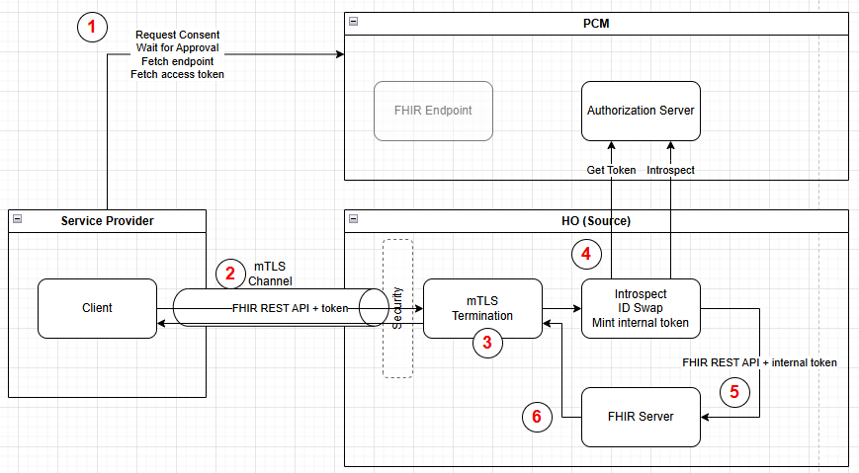

Slide 3
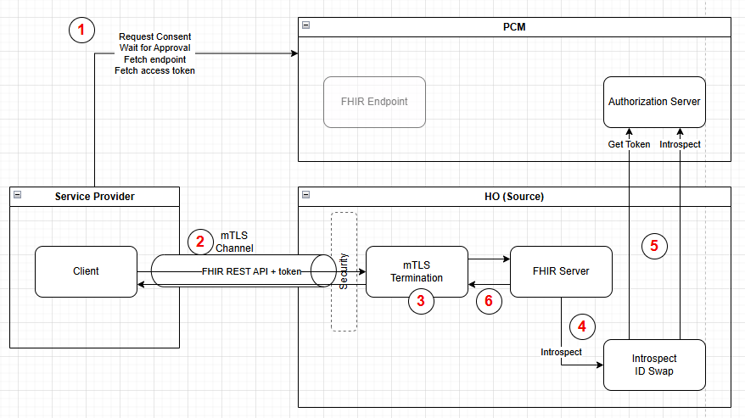

Slide 4
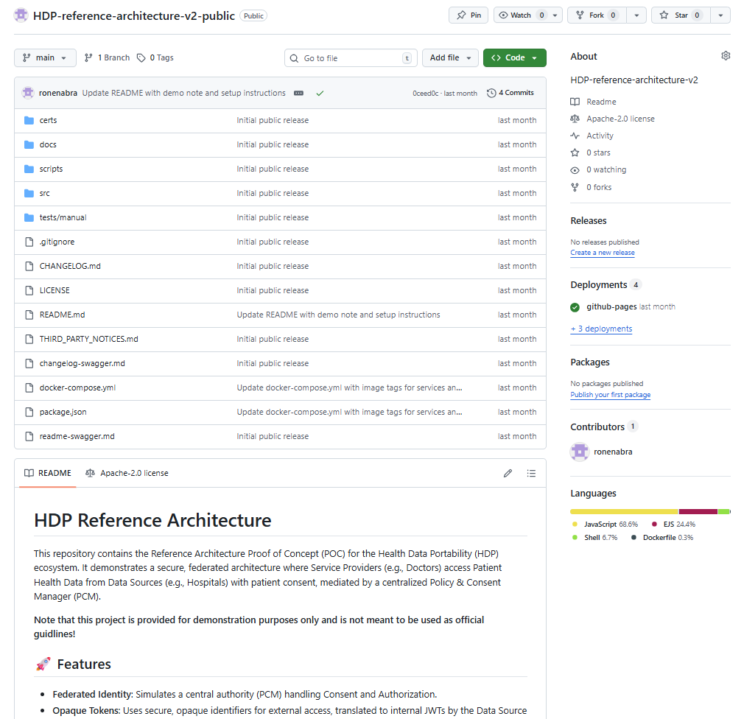
HDP reference architecture v2 - OSS https://github.com/ronenabra/HDP-reference-architecture-v2-public

